Slide 1
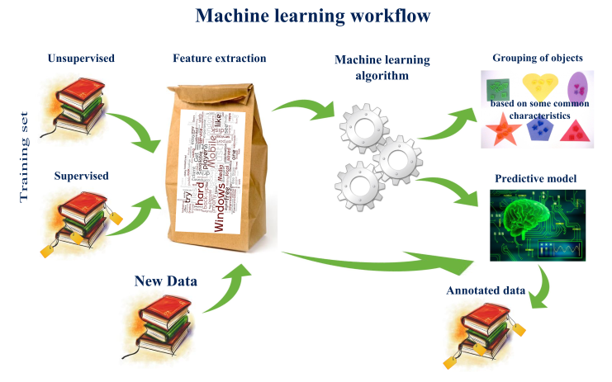
Predictive Modeling Project Template

Slide 2
Predictive Modeling Project Template
use a structured step-by-step process
Any predictive modeling machine learning project can be broken down into six common tasks:
Define Problem.
Summarize Data.
Prepare Data.
Evaluate Algorithms.
Improve Results.
Present Results.

Slide 3

Predictive Modeling Project Template
# b) Feature Selection
# c) Data Transforms
# 4. Evaluate Algorithms
# a) Split-out validation dataset
# b) Test options and evaluation metric
# c) Spot Check Algorithms
# d) Compare Algorithms
# 5. Improve Accuracy
# a) Algorithm Tuning
# b) Ensembles
# 6. Finalize Model
# a) Predictions on validation dataset
# b) Create standalone model on entire training dataset
# c) Save model for later use
# Python Project Template
# 1. Prepare Problem
# a) Load libraries
# b) Load dataset
# 2. Summarize Data
# a) Descriptive statistics
# b) Data visualizations
# 3. Prepare Data
# a) Data Cleaning
Template Summary

Slide 4

Predictive Modeling Project Template
how to use the project template
Create a new le for your project (e.g. project name.py).
Copy the project template.
Paste it into your empty project le.
Start to fill it in, using recipes from this book and others.

Slide 5
Predictive Modeling Project Template
Project Template Steps
Prepare Problem
Python modules, classes and functions that you intend to use.
Loading your dataset from CSV.
Summarize Data
Descriptive statistics such as summaries.
Data visualizations such as plots with Matplotlib, ideally using convenience functions from Pandas.
Prepare Data
Cleaning data by removing duplicates, marking missing values and even imputing missing values.
Feature selection where redundant features may be removed and new features developed.
Data transforms where attributes are scaled or redistributed in order to best expose the structure of the problem later to learning algorithms.

Slide 6
Predictive Modeling Project Template
Project Template Steps
Evaluate Algorithms
Separating out a validation dataset to use for later conrmation of the skill of your developed model.
Defining test options using scikit-learn such as cross validation and the evaluation metric to use.
Spot-checking a suite of linear and nonlinear machine learning algorithms.
Comparing the estimated accuracy of algorithms.
Improve Accuracy
Search for a combination of parameters for each algorithm using scikit-learn that yields the best results.
Combine the prediction of multiple models into an ensemble prediction using ensemble techniques.
Finalize Model
Using an optimal model tuned by scikit-learn to make predictions on unseen data.
Creating a standalone model using the parameters tuned by scikit-learn.
Saving an optimal model to le for later use.

Slide 7
tips for using the template well
Fast First Pass. Make a first-pass through the project steps as fast as possible.
Cycles. The process in not linear but cyclic. You will loop between steps, and probably spend most of your time in tight loops between steps 3-4 or 3-4-5 until you achieve a level of accuracy that is sufficient or you run out of time.
Attempt Every Step. It is easy to skip steps, especially if you are not confident or familiar with the tasks of that step.
Ratchet Accuracy. The goal of the project is model accuracy. Every step contributes towards this goal.
Adapt As Needed. Modify the steps as you need on a project, especially as you become more experienced with the template.

Slide 8
Predictive Modeling Project Template
how to use the project template
Create a new le for your project (e.g. project name.py).
Copy the project template.
Paste it into your empty project le.
Start to fill it in, using recipes from this book and others.

Slide 9
Predictive Modeling Project Template
how to use the project template
Create a new le for your project (e.g. project name.py).
Copy the project template.
Paste it into your empty project le.
Start to fill it in, using recipes from this book and others.

Slide 10
Predictive Modeling Project Template
how to use the project template
Create a new le for your project (e.g. project name.py).
Copy the project template.
Paste it into your empty project le.
Start to fill it in, using recipes from this book and others.

Slide 11
Predictive Modeling Project Template
how to use the project template
Create a new le for your project (e.g. project name.py).
Copy the project template.
Paste it into your empty project le.
Start to fill it in, using recipes from this book and others.

